Slide 1
Chapter 16
How to use jQueryUI and jQuery plugins
to enhance your web pages
Notes:
Session: Ghi số thứ tự session trong môn học
Session Name: ghi tên của session sẽ dạy
<number>

Slide 2
Objectives
Introduction to jQuery UI
How to use four of the most popular jQuery UI widget
Introduction to jQuery plugins
How to use three of the most popular plugins
Notes:
Mô tả nội dung mà học viên phải đạt được khi kết thúc môn học này
<number>

Slide 3
Introduction to jQuery UI
jQuery UI is a free, open-source, JavaScript library that extends the use of the jquery library.
jQuery UI provide higher level features that you can use with a minimum of code.
jQuery UI uses jQuery and can be thought of as the official plugin library for jQuery.
Get the jQuery UI from http://jqueryui.com

Slide 4
The four types of features provides by jQuery UI
Name | Description
Widgets Themes Interactions Effects | Accordions, tabs, date pickers, and more. 24 predefined themes as well as a ThemeRoller application. Draggable, droppable, resizable, and more. Color animations, class transitions and more

Slide 5
Include jQuery UI to your application
CSS file
<link rel = “stylesheet” href=“…./jquery-ui.css”>
JavaScripts
<script src=“…./jquery-2.1.3.min.js”> </script>
<script src=“…./jquery-ui.js”> </script>

Slide 6
How to use four of the most popular jQuery UI widget

Slide 7
jQuery UI for accordions
To build an accordion using jQuery and jQuery UI. An accordion consists of two or more panels that you can open by clicking on the heading for a panel. These panels open by sliding up or down, depending on the location of the panel.
To code the HTML for an accordion
Code a div element with “accordion” as its id
For the title of each panel in the accordion, code an <a> element within an h3 element
For the content of each panel, code a div element that contains whatever HTML elements the content requires.

Slide 8
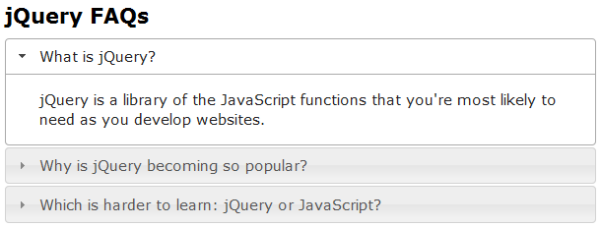
Example
An accordion within a web page

Slide 9
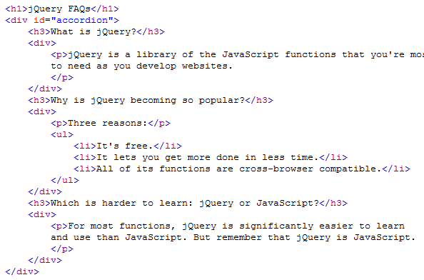
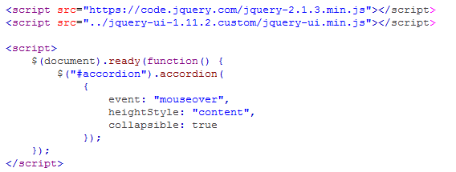
Code for accordion

Slide 10
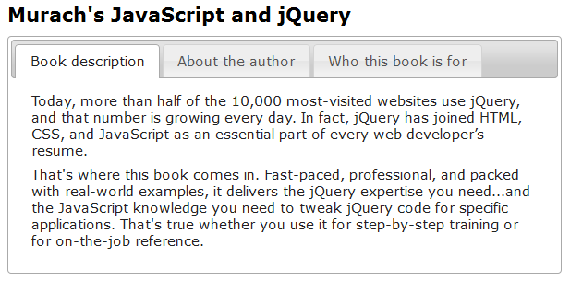
jQuery UI for Tabs widget

Slide 11
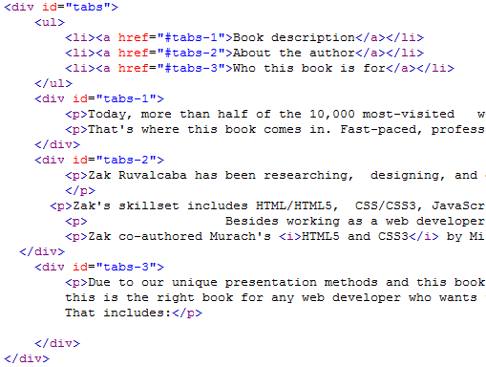
Code for Tabs widget

Slide 12
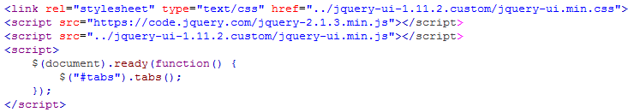
Code for Tabs widget

Slide 13
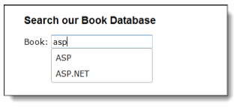
jQuery UI for auto-completion
To implement the auto-completion feature with jQuery UI. When this feature is implemented for a text box and the user starts an entry, a list of possible entries drops down from the box
A text box that displays an auto-completion list

Slide 14
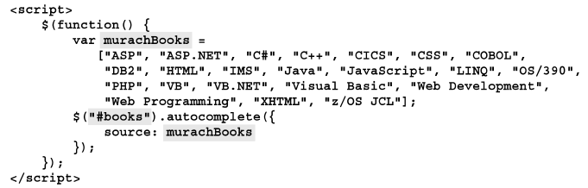

The code for auto-completion
The script element for auto-completion
The HTML for the text box

Slide 15
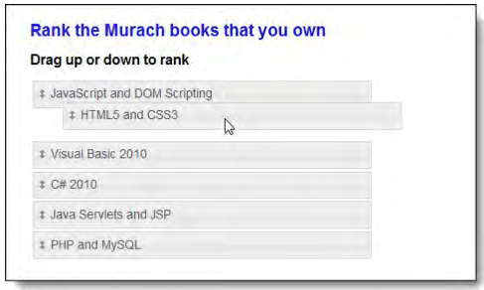
jQuery UI for sortable lists
Use jQuery UI to create a sortable list. A list is displayed when the web page is loaded. The user can drag the items in the list to new locations.
A sortable list as one of the items is dragged upward

Slide 16
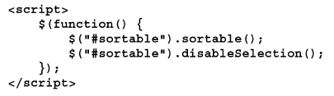
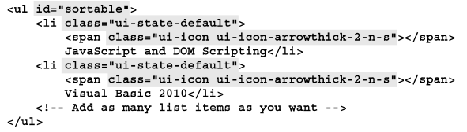
jQuery UI for sortable lists
The script element for the sortable list
The HTML for the sortable list

Slide 17
Introduction to jQuery plugins

Slide 18
Introduction to jQuery plugins
A jQuery plugin is just a jQuery application that does one web task or a set of related web tasks.
A plugin makes use of the jQuery library and most plugins can be used limited knowledge of JavaScript and jQuery.

Slide 19
Three the most popular plugins
Lightbox plugin for images
http://www.jqueryscript.net/lightbox/
bxSliders plugin for carousels
http://bxslider.com/
Cycle 2 plugin for slide shows
http://jquery.malsup.com/cycle2/

Slide 20
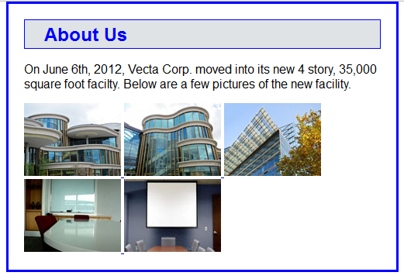
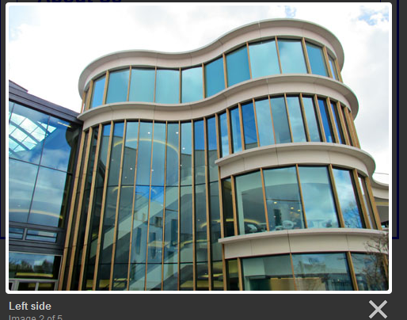
Lightbox plugin for images

Slide 21
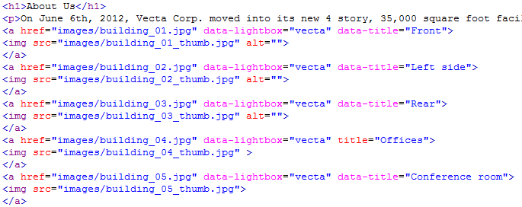
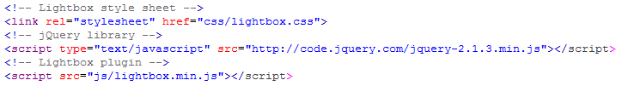
Lightbox plugin for images code

Slide 22
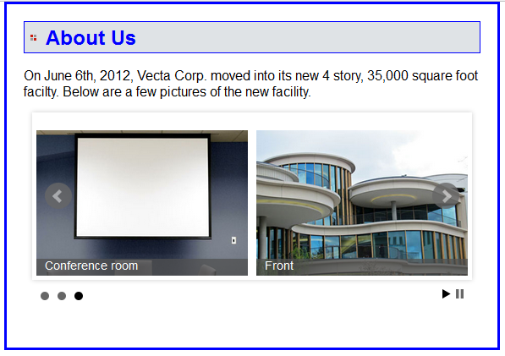
bxSliders plugin for carousels

Slide 23
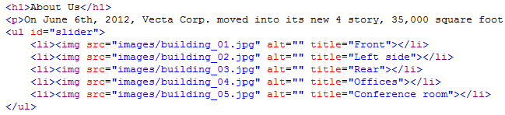
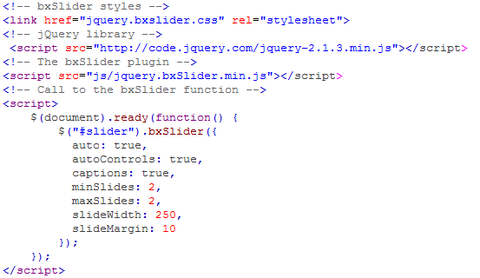
bxSliders plugin for carousels code

Slide 24
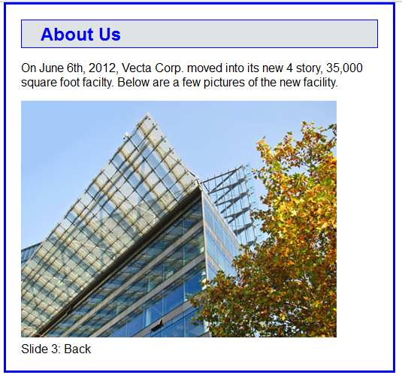
Cycle 2 plugin for slide shows

Slide 25
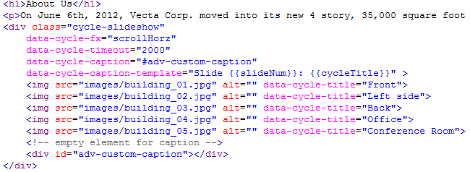

Cycle 2 plugin for slide shows code

Slide 26
Summary
jQuery UI is a related JavaScript that uses the jQuery library to build higher-level features
Four common uses of jQuery UI that can be copied into pages are accordions, auto-completion, popup dialog boxes, and sortable lists
A jQuery plugin is just a jQuery application that does one web task or a set of related web tasks.
Thre common uses of jQuery plugins are Lightbox, bxSlider, Cycle 2.
Notes:
Tóm tắt lại nội dung đã học
<number>

